Slide 1
14
Other C Topics

Slide 2
We’ll use a signal I have tried and found
far-reaching and easy to yell. Waa-hoo!
  Zane Grey
It is quite a three-pipe problem.
  Sir Arthur Conan Doyle

Slide 3
OBJECTIVES
In this chapter you will learn:
To redirect keyboard input to come from a file.
To redirect screen output to be placed in a file.
To write functions that use variable-length argument lists.
To process command-line arguments.
To assign specific types to numeric constants.
To use temporary files.
To process external asynchronous events in a program.
To allocate memory dynamically for arrays.
To change the size of memory that was dynamically allocated previously.

Slide 4
14.1 Introduction
14.2 Redirecting Input/Output on Linux/UNIX and Windows Systems
14.3 Variable-Length Argument Lists
14.4 Using Command-Line Arguments
14.5 Notes on Compiling Multiple-Source-File Programs
14.6 Program Termination with exit and at exit

Slide 5
14.7 volatile Type Qualifier
14.8 Suffixes for Integer and Floating-Point Constants
14.9 More on Files
14.10 Signal Handling
14.11 Dynamic Memory Allocation: Functions calloc and realloc
14.12 Unconditional Branching with goto

Slide 6
14.1 Introduction
Several advanced topics in this chapter
Operating system specific
  Usually UNIX or DOS

Slide 7
14.2 Redirecting Input/Output on UNIX and DOS Systems
Standard I/O - keyboard and screen
  Redirect input and output
Redirect symbol(<)
  Operating system feature, not a C feature
  UNIX and DOS
  $ or % represents command line
  Example:
      $ sum < input
  Rather than inputting values by hand, read them from a file
Pipe command(|)
  Output of one program becomes input of another
      $ random | sum
  Output of random goes to sum

Slide 8
14.2 Redirecting Input/Output on UNIX and DOS Systems
Redirect output (>)
  Determines where output of a program goes
  Example:
      $ random > out
    Output goes into out (erases previous contents)
Append output (>>)
  Add output to end of file (preserve previous contents)
  Example:
      $ random >> out
    Output is added onto the end of out

Slide 9
14.3 Variable-Length Argument Lists
Functions with unspecified number of arguments
  Load <stdarg.h>
  Use ellipsis(...) at end of parameter list
  Need at least one defined parameter
  Example:
      double myfunction ( int i, ... );
  The ellipsis is only used in the prototype of a function with a variable length argument list
  printf is an example of a function that can take multiple arguments
  The prototype of printf is defined as
      int printf( const char* format, ... );

Slide 10
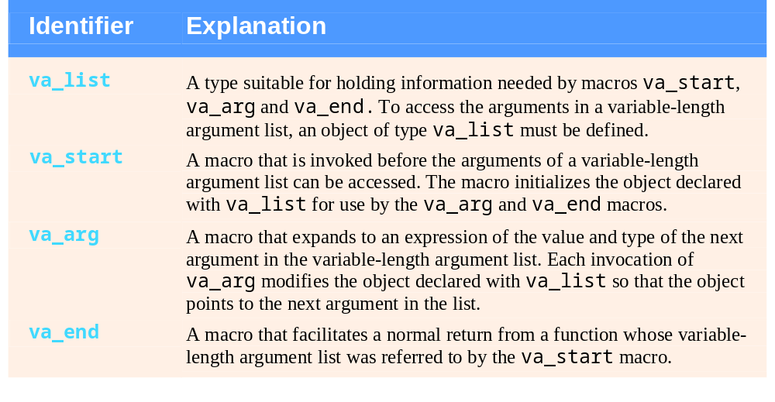
Fig. 14.1 | stdarg.h variable-length argument list type and macros.

Slide 11
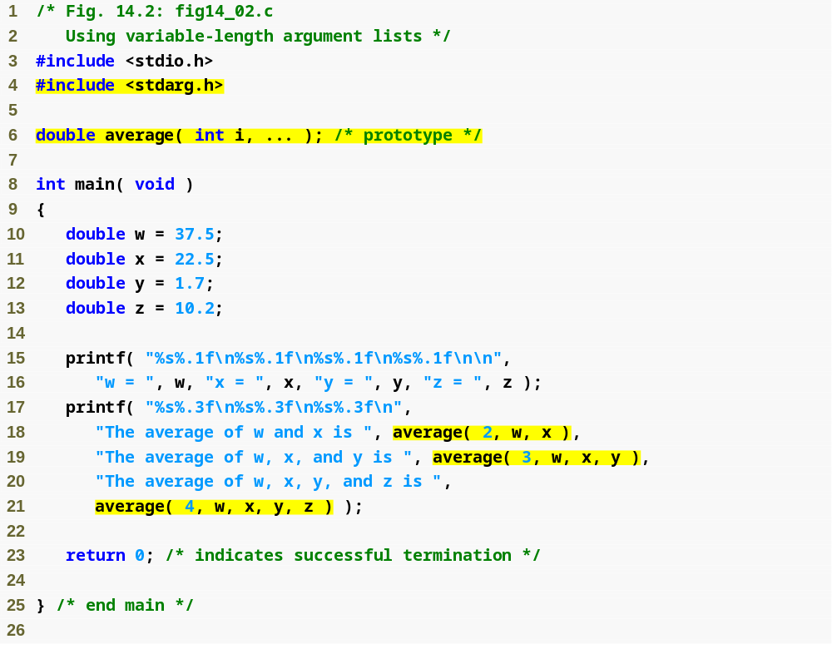
Outline
fig14_02.c
(1 of 2 )
Function average takes an integer i and an unspecified number of additional arguments

Slide 12
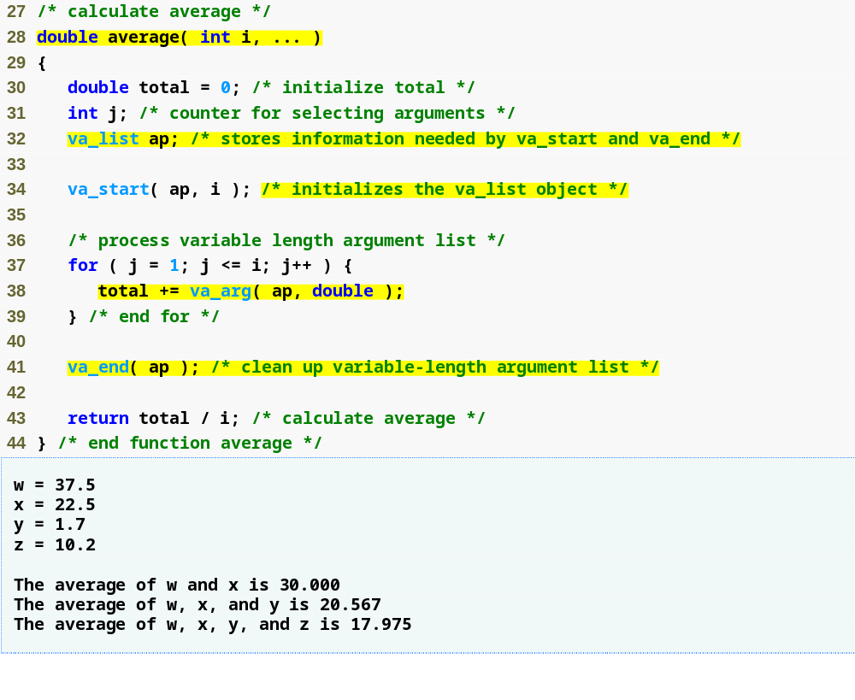
va_list variable holds information for other variable-argument macros
Outline
fig14_02.c
(2 of 2 )
va_start macro initializes ap with i elements
va_arg macro retrieves next element from ap and converts it to type double
va_end macro allows the function to facilitate a normal return to main

Slide 13
Common Programming Error 14.1
Placing an ellipsis in the middle of a function parameter list is a syntax error. An ellipsis may only be placed at the end of the parameter list.

Slide 14
14.4 Using Command-Line Arguments
Pass arguments to main on DOS or UNIX
  Define main as
      int main( int argc, char *argv[] )
  int argc
    Number of arguments passed
  char *argv[]
    Array of strings
    Has names of arguments in order
      argv[ 0 ] is first argument
  Example: $ mycopy input output
    argc: 3
    argv[ 0 ]: “mycopy"
    argv[ 1 ]: "input"
    argv[ 2 ]: "output"

Slide 15
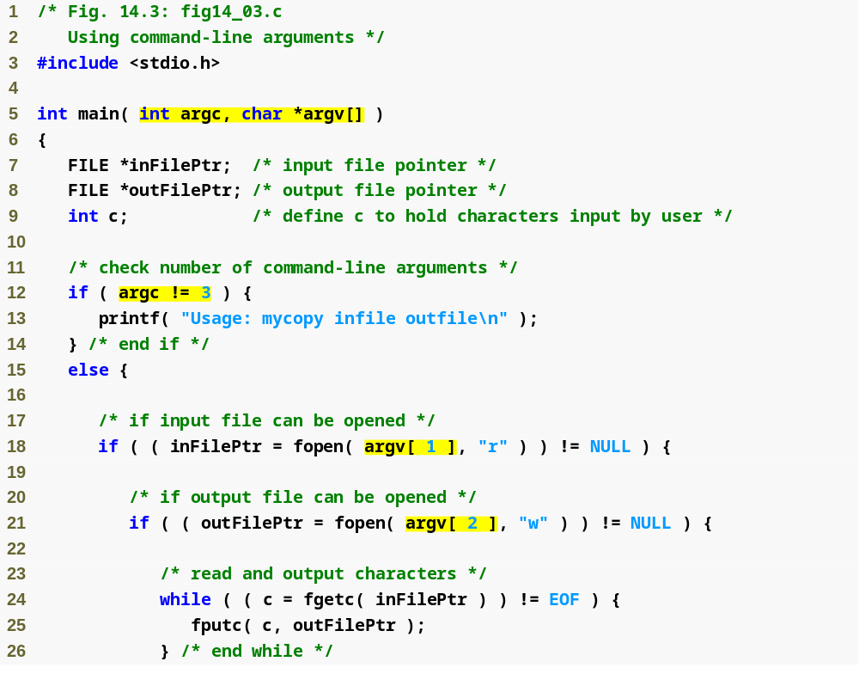
Outline
Notice that main takes arguments argc and argv
fig14_03.c
(1 of 2 )
The program is passed three arguments: the name of the program, the name of the file to be read from, and the name of the file to write to.
The program attempts to open the file specified by argv[1] for reading...
...then attempts to open the file specified by argv[2] for writing.
The program takes each character from inFilePtr and writes them to outFilePtr

Slide 16
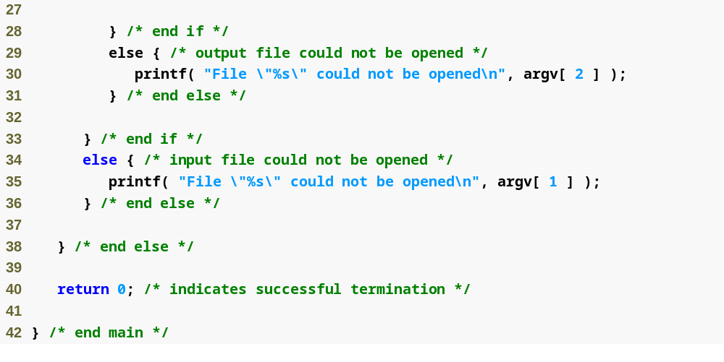
Outline
fig14_03.c
(2 of 2 )

Slide 17
14.5 Notes on Compiling Multiple Source-File Programs
Programs with multiple source files
  Function definition must be in one file (cannot be split up)
  Global variables accessible to functions in same file
    Global variables must be defined in every file in which they are used
  Example:
    If integer flag is defined in one file
    To use it in another file you must include the statement
      extern int flag;
  extern
    States that the variable is defined in another file
  Function prototypes can be used in other files without an extern statement
    Have a prototype in each file that uses the function

Slide 18
14.5 Notes on Compiling Multiple Source-File Programs
Keyword static
  Specifies that variables can only be used in the file in which they are defined
Programs with multiple source files
  Tedious to compile everything if small changes have been made to only one file
  Can recompile only the changed files
  Procedure varies on system
    UNIX: make utility

Slide 19
Software Engineering Observation 14.1
Global variables should be avoided unless application performance is critical because they violate the principle of least privilege.

Slide 20
Software Engineering Observation 14.2
Creating programs in multiple source files facilitates software reusability and good software engineering. Functions may be common to many applications.
In such instances, those functions should be stored in their own source files, and each source file should have a corresponding header file containing function prototypes. This enables programmers of different applications to reuse the same code by including the proper header file and compiling their applications with the corresponding source file.

Slide 21
14.6 Program Termination with exit and atexit
Function exit
  Forces a program to terminate
  Parameters – symbolic constants EXIT_SUCCESS or EXIT_FAILURE
  Returns an implementation-defined value
  Example:
      exit( EXIT_SUCCESS );
Function atexit
      atexit( functionToRun );
  Registers functionToRun to execute upon successful program termination
    atexit itself does not terminate the program
  Register up to 32 functions (multiple atexit() statements)
    Functions called in reverse register order
  Called function cannot take arguments or return values

Slide 22
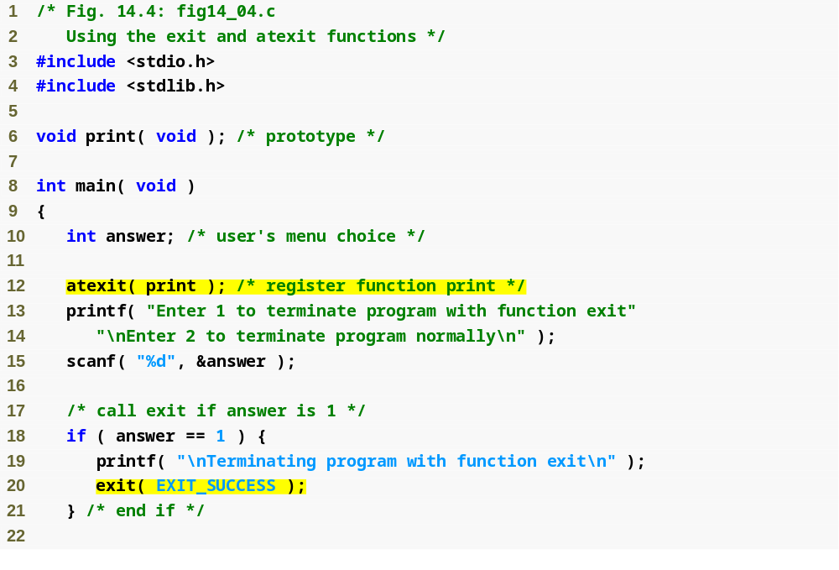
Outline
fig14_04.c
(1 of 2 )
atexit function instructs program to call function print when the program terminates
exit function forces program to terminate

Slide 23
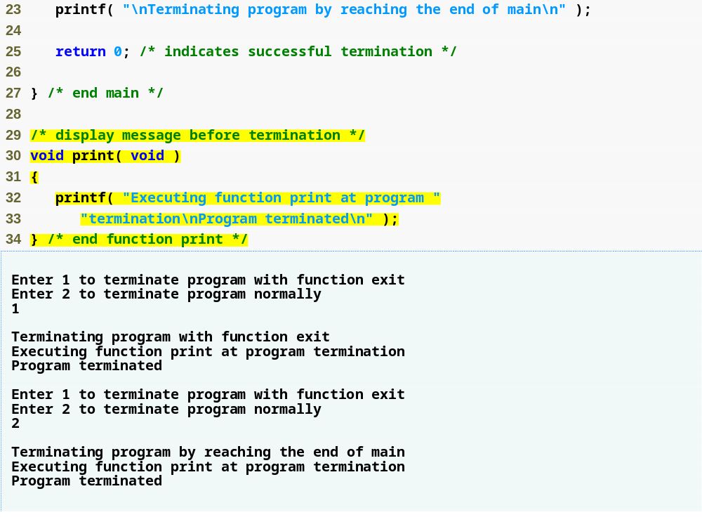
Outline
fig14_04.c
(2 of 2 )
print function is called at program termination

Slide 24
14.7 volatile Type Qualifier
volatile qualifier
  Variable may be altered outside program
  Variable not under control of program
  Variable cannot be optimized

Slide 25
14.8 Suffixes for Integer and Floating-Point Constants
C provides suffixes for constants
  unsigned integer – u or U
  long integer – l or L
  unsigned long integer – ul, lu, UL or LU
  float – f or F
  long double – l or L
  Examples:
        174u
        467L
        3451ul
  If integer constant is not suffixed type determined by first type capable of storing a value of that size (int, long int, unsigned long int)
  If floating point not suffixed of type double

Slide 26
14.9 More on Files
C can process binary files
  Not all systems support binary files
    Files opened as text files if binary mode not supported
  Binary files should be used when rigorous speed, storage, and compatibility conditions demand it
  Otherwise, text files are preferred
    Inherent portability, can use standard tools to examine data
Function tmpfile
  Opens a temporary file in mode "wb+"
    Some systems may process temporary files as text files
  Temporary file exists until closed with fclose or until program terminates
Function rewind
  Positions file pointers to the beginning of the file

Slide 27
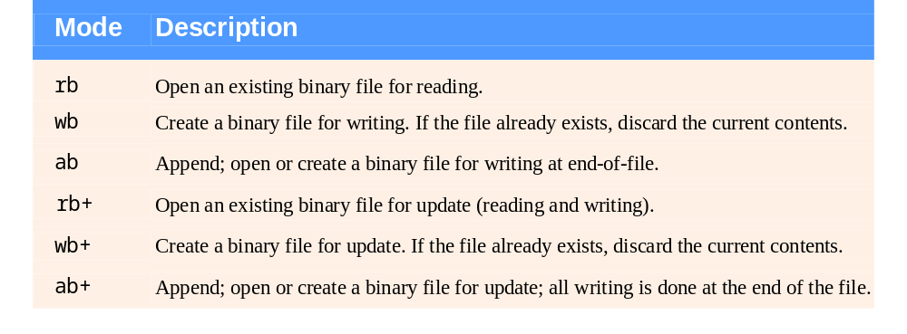
Fig. 14.5 | Binary file open modes.

Slide 28
Performance Tip 14.1
Consider using binary files instead of text files in applications that demand high performance.

Slide 29
Portability Tip 14.1
Use text files when writing portable programs.

Slide 30
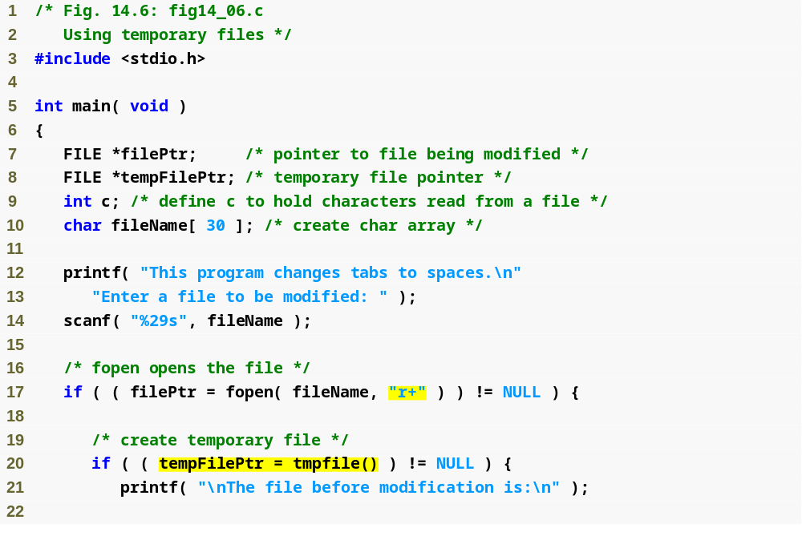
Outline
fig14_06.c
(1 of 3 )
tmpfile function creates a temporary file

Slide 31
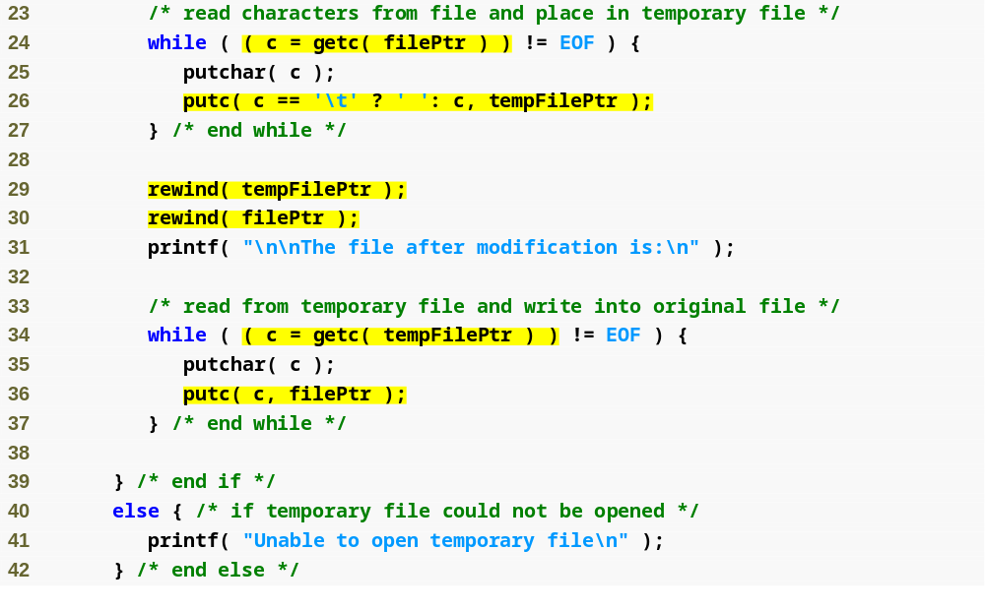
Outline
fig14_06.c
(2 of 3 )
The program takes characters from filePtr and places them in tempFilePtr, converting tabs into spaces
The program then takes characters from tempFilePtr and places them in filePtr.

Slide 32
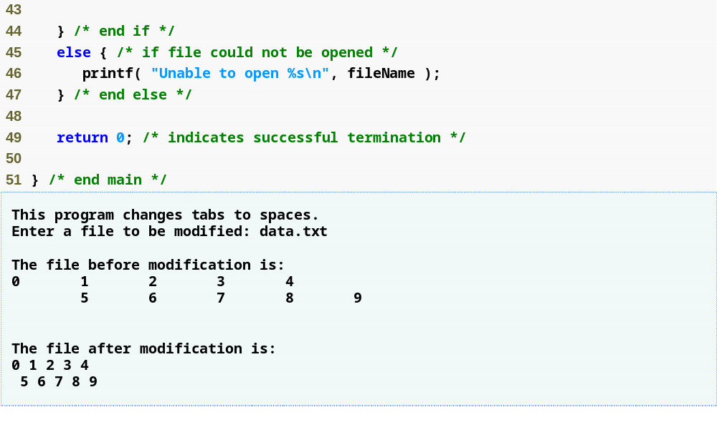
Outline
fig14_06.c
(3 of 3 )

Slide 33
14.10 Signal Handling
Signal
  Unexpected event, can terminate program
    Interrupts (<ctrl> c), illegal instructions, segmentation violations, termination orders, floating-point exceptions (division by zero, multiplying large floats)
Function signal
  Traps unexpected events
  Header <signal.h>
  Receives two arguments: a signal number and a pointer to the signal handling function
Function raise
  Takes an integer signal number and creates a signal

Slide 34
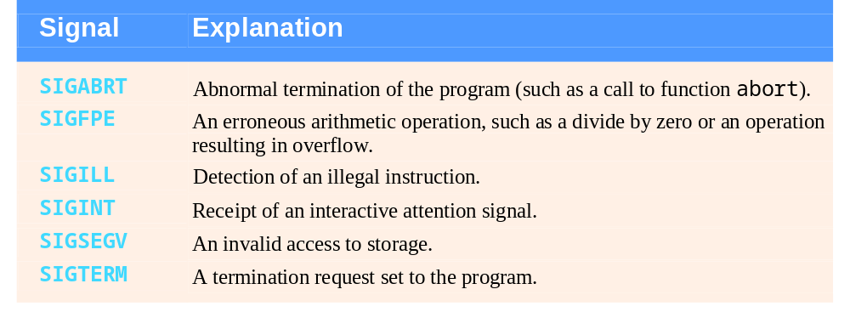
Fig. 14.7 | signal.h standard signals.

Slide 35
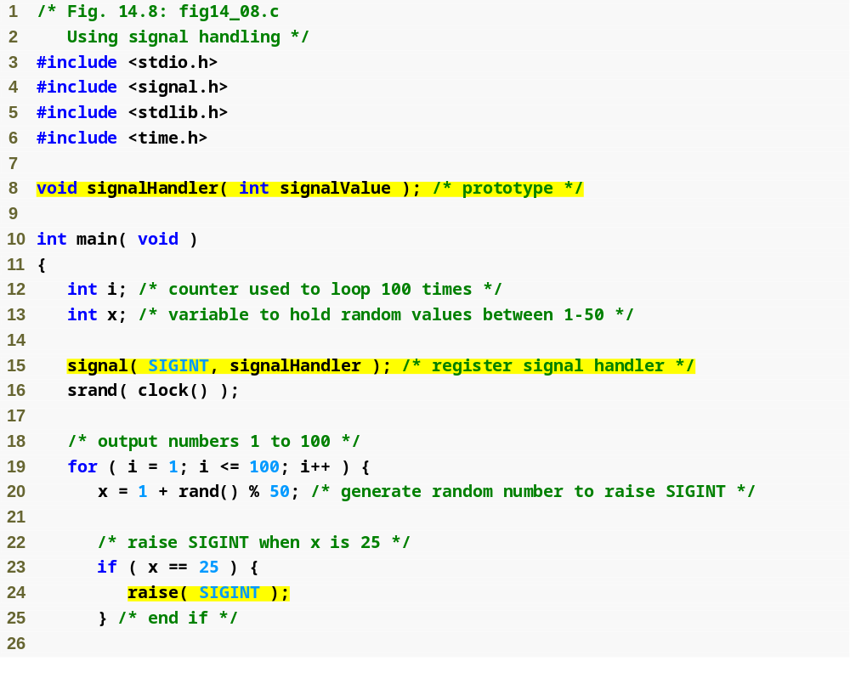
Outline
fig14_08.c
(1 of 3 )
signal function instructs program to call signalHandler if a SIGINT signal is detected
raise function causes a SIGINT signal to occur

Slide 36
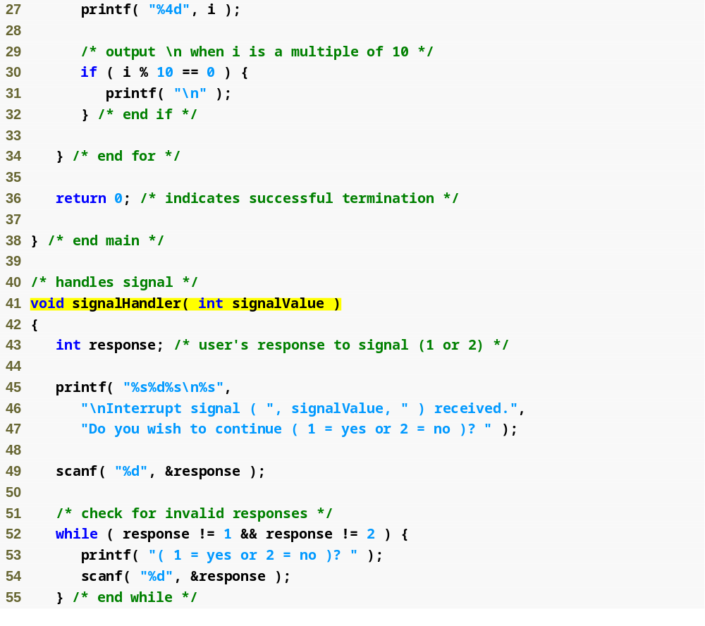
Outline
fig14_08.c
(2 of 3 )

Slide 37
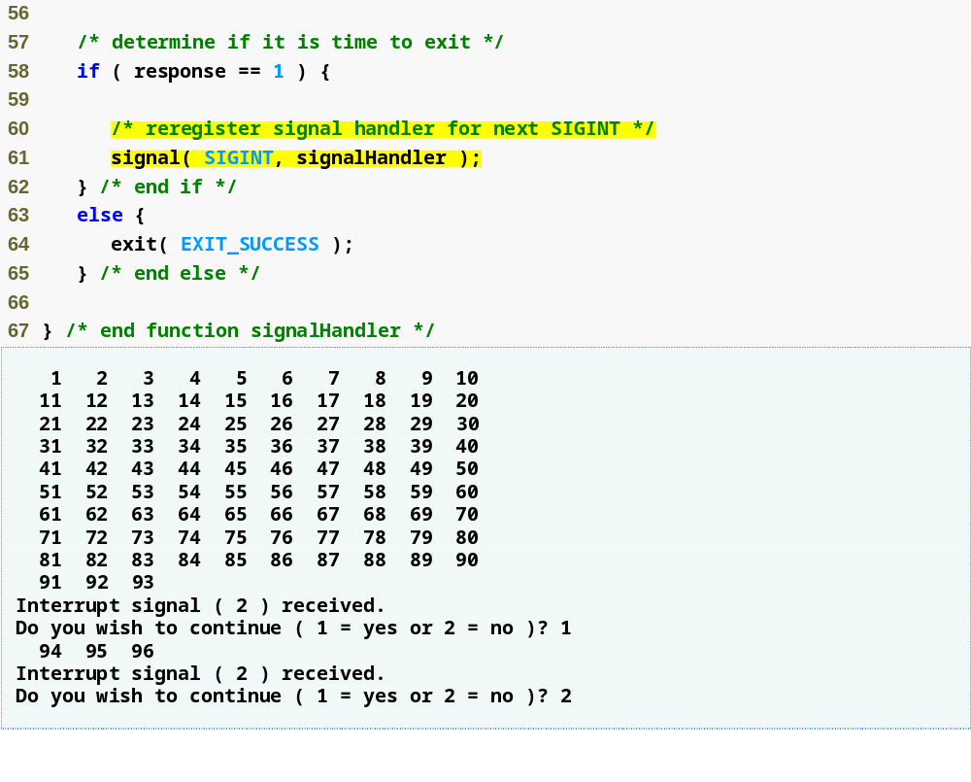
Outline
fig14_08.c
(3 of 3 )
signal function must be called again after a signal occurs

Slide 38
14.11 Dynamic Memory Allocation: Functions calloc and realloc
Dynamic memory allocation
  Can create dynamic arrays
calloc( nmembers, size )
  nmembers – number of elements
  size – size of each element
  Returns a pointer to a dynamic array
realloc( pointerToObject, newSize )
  pointerToObject – pointer to the object being reallocated
  newSize – new size of the object
  Returns pointer to reallocated memory
  Returns NULL if cannot allocate space
  If newSize equals 0 then the object pointed to is freed
  If pointerToObject equals 0 then it acts like malloc

Slide 39
14.12 Unconditional Branching with goto
Unstructured programming
  Use when performance crucial
  break to exit loop instead of waiting until condition becomes false
goto statement
  Changes flow control to first statement after specified label
  A label is an identifier followed by a colon (i.e. start:)
  Quick escape from deeply nested loop
    goto start;

Slide 40
Performance Tip 14.2
The goto statement can be used to exit deeply nested control structures efficiently.

Slide 41
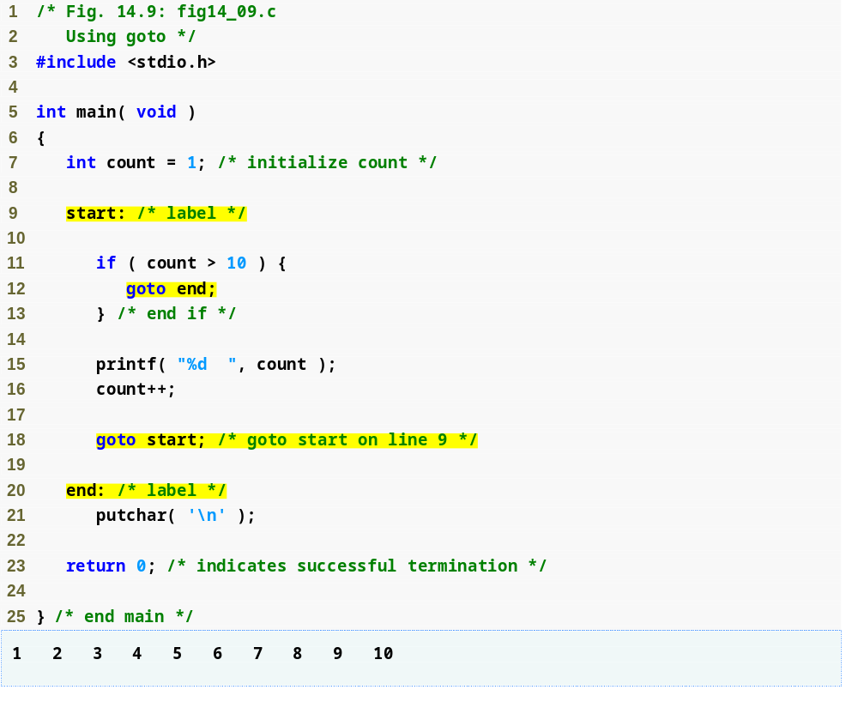
Outline
fig14_09.c
Labels for use with goto statement
goto statement sends program to specified label

Slide 42
Software Engineering Observation 14.3
The goto statement should be used only in performance-oriented applications. The goto statement is unstructured and can lead to programs that are more difficult to debug, maintain and modify.

